Slide 1
RESUME CONT… Good to Great
Focus on skills NOT duties

Slide 2
Customer Service Rep (MasterCard)
Complete required training
Answer incoming calls
Provide customer service
Handle upset/angry customers
Resolve customer account issues
Document interaction with customer
Communication skills
Customer service
Problem solving
Patience
Product knowledge
Attention to detail
Confidentiality
Computer skills
Teamwork
Company police/quality standards
DUTIES
SKILLS

Slide 3
Experience Examples:
Communicate products and provide above average customer service to new and existing customers
Address customer service inquires in a timely and professional fashion ensuring accurate information is being communicated
Made rational procedure exceptions to accommodate unusual customer requests to ensure customer satisfaction, following all company policies and procedures
Achieved customer satisfaction rating of 95% for six consecutive months, exceeding corporate targets by 10%
Participated in team meetings and engaged in corporate social/team building events

Slide 4
EXPERIENCE: Example
Customer Service Representative 2015 – 2016
Mastercard, Toronto ON
Communicate products and provide above average customer service to new and existing customers
Address customer service inquires in a timely and professional fashion ensuring accurate information is being communicated
Made rational procedure exceptions to accommodate unusual customer requests to ensure customer satisfaction, following all company policies and procedures
Achieved customer satisfaction rating of 95% for six consecutive months, exceeding corporate targets by 10%
Participated in team meetings and engaged in corporate social/team building events

Slide 5
ACCOMPLISHMENT STATEMENTS
Formula for Accomplishment Statements:
Action Verb + Task + Result
Accomplishment Statements = bullet points that go under Relevant Projects, Work Experience, Other Experience, Volunteer Experience, and sometimes Education

Slide 6
Accomplishment Statements
https://lambton.optimalresume.com/
Accomplishment statements
Many, many resources online re: statements!
Trained new employees (good idea to start/ need to make into Statements)
Trained new employees resulting in increased customer satisfaction
Trained more than 15 new employees over a 12 month period
Trained 15+ new employees over a 12 month period resulting in a 25% increase in customer satisfaction
OR
Increased customer satisfaction by 25% through effectively training 15+ new employees over 1 year
*Both are good, it just depends on what skill(s) you’re trying to get across (increased customer satisfaction vs. leadership/training)
Notes:
Example shows how to start with an idea and make it into an accomplishment statement; both examples in bold show great accomplishment statements, just with different showcased skills

Slide 7
In-Class Activity
Change statements into accomplishment statements by using the formula
Provide customer service
Retain customer relationships
Analyze client finances
Prepare financial statements
Sell products and place customer order
Notes:
Note: instructors can change to program specific duties

Slide 8
Good to Great…
It’s not just what you know…it’s what you have done with what you know!

Slide 9
Cover Letters

Slide 10
Purpose: To entice them to look at your resume
Introduce yourself and state your object
Sell yourself, highlighting how you meet the requirements
Keep it employer focused
Create a NEW cover letter for each job posting!!!

Slide 11
Does it answer this question:
“WHY SHOULD I HIRE YOU?”

Slide 12
CHARACTERISTICS OF A GOOD COVER LETTER:
Makes a good first impression
Original and specific to each job application situation
Direct and to the point
1 page or less
Paper, Font & Style match your resume

Slide 13
COMMON PITFALLS
Overuse of “I” statements
Don’t focus on what you want – focus on employer wants
Example: I am looking forward to obtaining skills and experience in this position
Failure to market yourself according to the job requirements
Lack of technical skills that relate to the job requirements
Example: only mentioning soft skills such as communication, teamwork, reliable, etc.
Not providing proof of when / how you have used the skills
Example: I have excellent MS Excel skills.
Improper spelling/sentence/paragraph structure

Slide 14
COVER LETTER STRUCTURE
Your Heading (match resume) (Name, address, contact info)
Date
Contact Name/their job title
Full Company Address
Re: Job Title
Salutation (Mr.,/Ms.)
Do not use first name, unless you are using their full name
Paragraph Structure
Closing
Enclosure

Slide 15
MARKETING YOURSELF
Focus on the employers JOB REQUIREMENTS
Refer to the job posting
Demonstrate how YOUR education, experience & skills make you a
QUALIFIED CANDIDATE
for the job
http://chk.tbe.taleo.net/chk01/ats/careers/requisition.jsp?org=SANDVINE&cws=1&rid=1346&source=Indeed.com

Slide 16
INTRODUCTION (1ST Paragraph)
This is the purpose of your letter.
What position are you applying for with what company?
Who are you (education / experience)?
How do you fit the position (think of 2-3 skills/abilities/strengths)?
Good Example:
“I am pleased to submit my application for the position of Health & Safety Intern, as advertised on the Lambton College myCareer website. As a current student in the Occupational Health & Safety program with 2+ years of Human Resource experience…”
Bad Example:
“I am applying for a position in your company found on your website. I am interested in the position to gain experience and develop my skills. I feel my knowledge and experience directly match the requirements.”

Slide 17
EDUCATION (2nd paragraph)
Discuss what have you gained from your post secondary
education that qualifies you for the position.
Provide application of mentioned skills!
Example:
“As mentioned, I am currently enrolled in the Occupational Health & Safety program at Lambton College in Toronto where I have completed an extensive Risk Management project which focused on identifying hazards around Lambton College’s campus. To identify the hazards, I …….”

Slide 18
EXPERIENCE & SKILLS (3rd paragraph)
What specific experience and skills have you gained from work, volunteering, recreational activities etc. that qualify you for the position?
“ While working as a Human Resource Assistant at ABC Health Group, I developed excellent analytical and leadership skills as I lead an initiative to identify health and safety training gaps for current employees. Through the initiative I was able to increase employee training satisfaction by 60% over the course of a year.”
Notes:
Instructors: add a relevant experience to your program

Slide 19
BE SPECIFIC!
Provide specific details and examples of your qualifications, training and experience
Include skills you are currently learning in your program
Include specific employment information and skills/accomplishments

Slide 20
CLOSING - (4TH Paragraph)
Thank the reader, request an interview and include contact information. You should also include the position and reference the company again.
“Thank you for reviewing my resume. I look forward to further discussion of my qualifications in person. I can be reached at 519 555 2222 or by email at _______ to schedule an interview.”

Slide 21
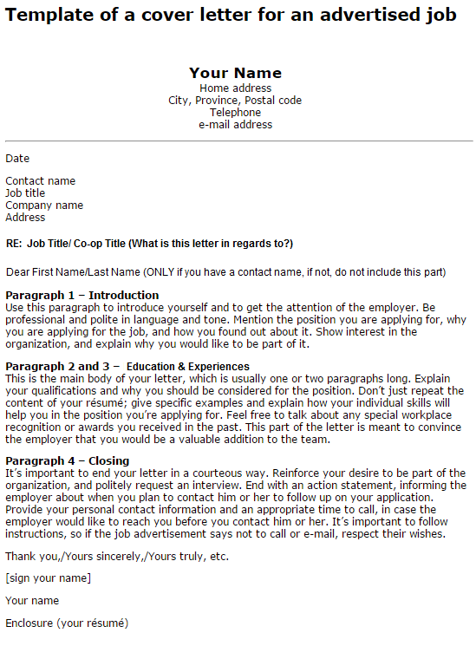

Slide 22
Email Etiquette
Professional email account- do not use Lambton email
Keep it Brief - straight to the point
Clear subject line - state position
Ie- Subject Line: Health & Safety Intern #12345 (position ID Number)
Salutation:
avoid Hello, Greetings, Good Morning
Use formal greeting i.e.- Dear Joe Smith, (first AND last name) or Dear Mr. Smith

Slide 23
Email Etiquette Cont…
Body of Email:
State purpose of email, why are you writing?
Include Signature
First Name / Last Name Email Address Cell Phone LinkedIn Profile (Optional)
PROOFREAD / Attach all necessary documents!
Send copy of email to yourself FIRST as test run

Slide 24
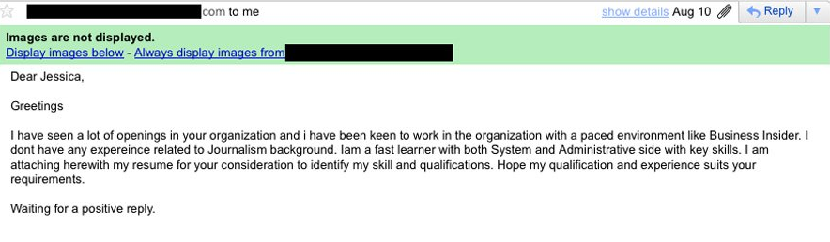
Email Etiquette- bad example
Notes:
Ask students what is wrong with the following two examples

Slide 25
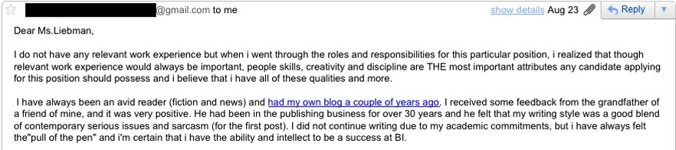
Email Etiquette- bad example

Slide 26
Week #5 – Online Work
The Benefit of Volunteering – Read:
http://idealistcareers.org/5-ways-volunteering-can-help-job-career/
Networking – Read:
https://www.livecareer.com/quintessential/networking-dos-donts
Submit (word count: 200): Discuss your own personal volunteer experiences and reasons why you do volunteer or reasons why you do not volunteer
Submit: Identify 3 different potential networking opportunities
Upcoming Toronto networking opportunities – dates, times and locations
Submit both in one (1) PDF or MS Office file

